Slide 1
Annual Day of my School

Slide 2
Introduction to Annual Day
Purpose: Celebrating the achievements and talents of students and faculty.
History: A brief note about how the Annual Day has been celebrated in the past years.
Significance: Importance of coming together as a college community.
Image/Visual: A snapshot of last year's event or a group photo of attendees.

Slide 3
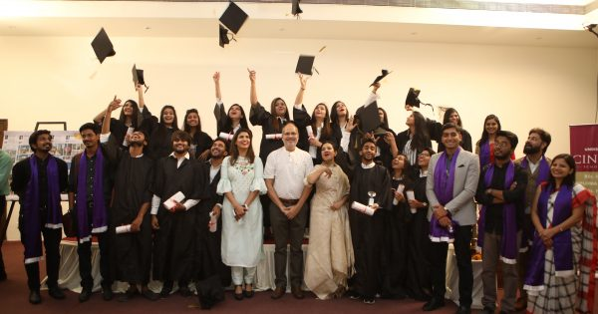
This Photo by Unknown Author is licensed under CC BY-SA-NC

Slide 4
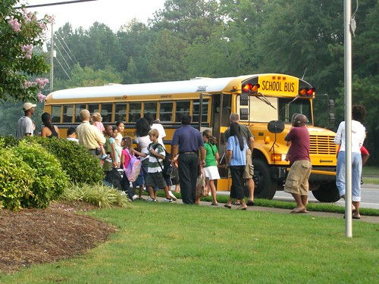
This Photo by Unknown Author is licensed under CC BY

